Slide 1
ER Modeling
Kazi Amit Hasan

Slide 2
Always careful about
Weak entity sets
Relationships
Check for specialization constraints

Slide 3
Weak Entities
Weak entities do not have any primary key
They cannot be identified on their own, so they depend on some other entity (known as owner entity)
The weak entities have total participation constraints (existence dependency) in its identifying relationship with owner identity
Weak entity types have partial keys. Partial keys are set of attributes, with the help of which the tuples of weak entities can be identified and distinguished.

Slide 4
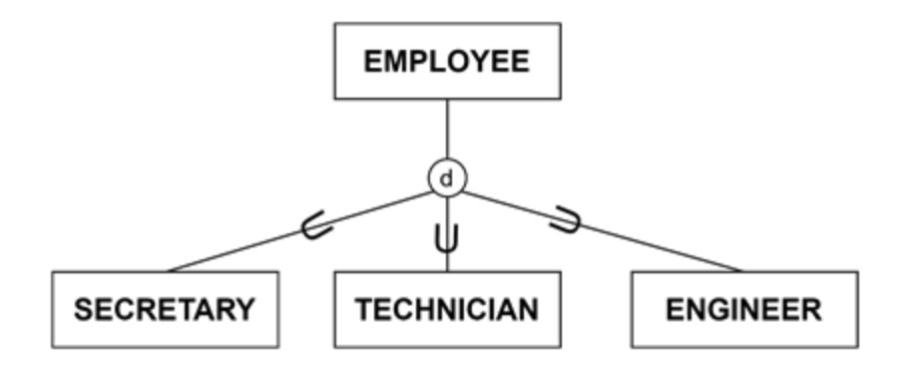
Specialization (extended ER model)
Specialization focuses on dividing a general entity type, or superclass, into smaller, more specific categories called subclasses

Slide 5
Question
We will store information about pets and those who adopt them.
Pets have a unique identifier, an animal type (dog, cat, guinea pig…) and we store the colour(s) of the pet.
People have unique first name/last name combinations, and an address. Pets are adopted by a sole person.
People can adopt many pets.
People and pets will only be in our database if they have adopted or been adopted.
We keep track of the date at which the pet was adopted
Pets are adopted from a shelter. The shelter has a name, an address, a list of the types of animals that can be housed, and a total number of animals that can be housed.
Only guinea pigs are weighed each day.
Dogs are each assigned a dog walker at the shelter. The dog walkers have a unique identifier, a name and a phone number.

Slide 6
Question
We will store information about pets and those who adopt them.
Pets have a unique identifier, an animal type (dog, cat, guinea pig…) and we store the colour(s) of the pet.
People have unique first name/last name combinations, and an address. Pets are adopted by a sole person.
People can adopt many pets.
People and pets will only be in our database if they have adopted or been adopted.
We keep track of the date at which the pet was adopted
Pets are adopted from a shelter. The shelter has a name, an address, a list of the types of animals that can be housed, and a total number of animals that can be housed.
Only guinea pigs are weighed each day.
Dogs are each assigned a dog walker at the shelter. The dog walkers have a unique identifier, a name and a phone number.

Slide 7
Identify the entity sets
Pets:
People:
Shelter:
Walker:
Weight:

Slide 8
Identify the relevant attributes
Pets: ID, type, color(s)
People: unique first name/last name combinations, and an address
Shelter:a name, an address, a list of the types of animals
Walker: unique identifier, a name and a phone number.
Weight

Slide 9
Identify the primary keys (and any other keys)
Pets: ID, type, color
People: unique first name/last name combinations, and an address
Shelter:a name, an address, a list of the types of animals
Walker: unique identifier, a name and a phone number.
Weight:

Slide 10
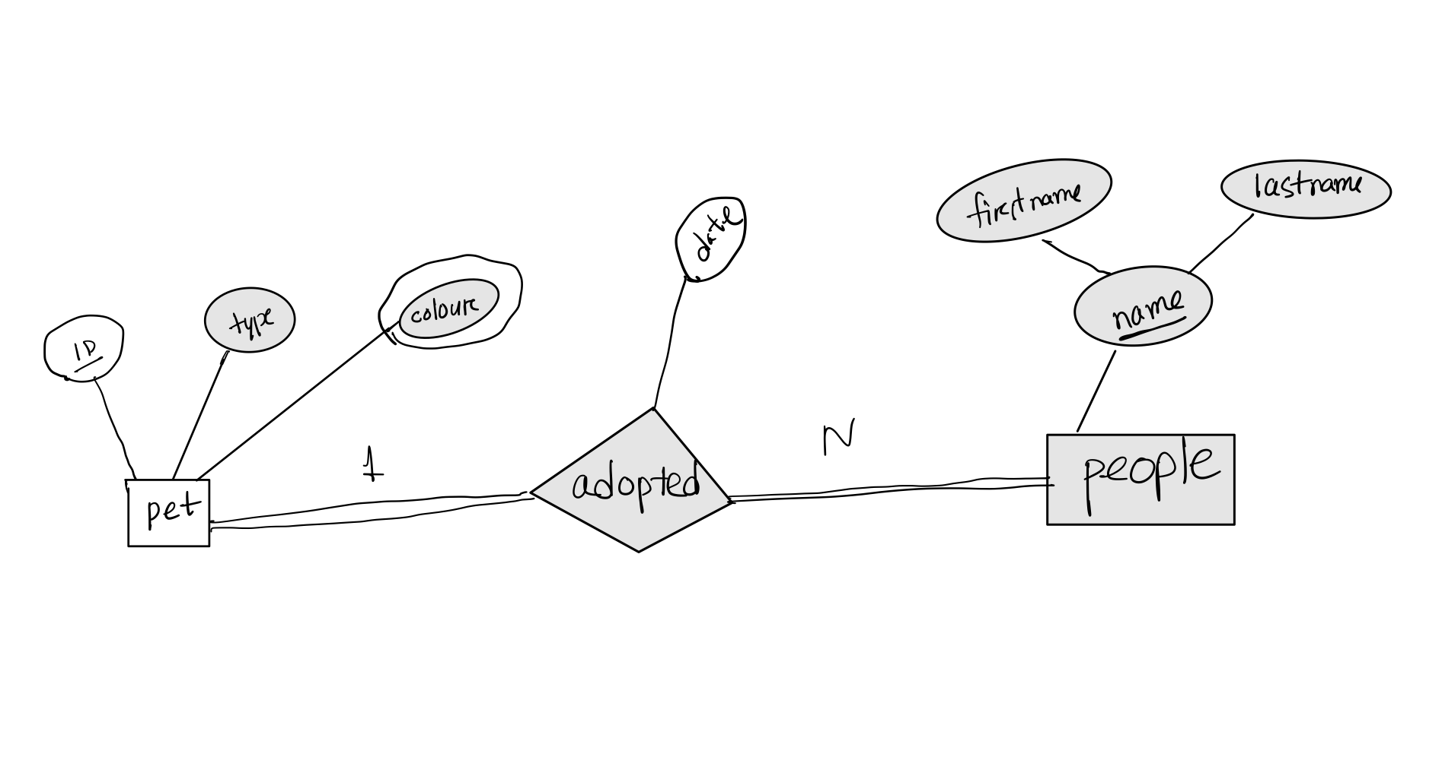
Identify the relationships
Pets have a unique identifier, an animal type (dog, cat, guinea pig…) and we store the colour(s) of the pet.
People have unique first name/last name combinations, and an address. Pets are adopted by a sole person.
People and pets will only be in our database if they have adopted or been adopted.
We keep track of the date at which the pet was adopted

Slide 11
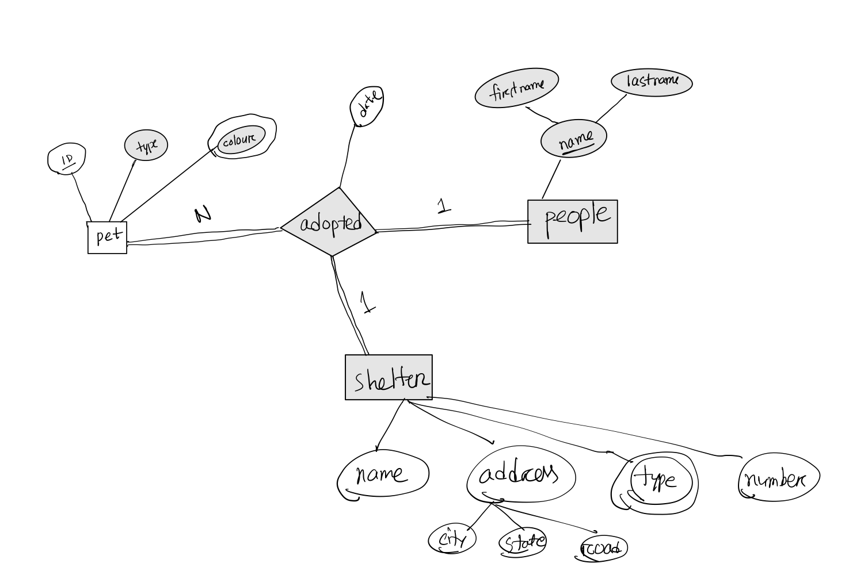
Identify the relationships
Pets are adopted from a shelter. The shelter has a name, an address, a list of the types of animals that can be housed, and a total number of animals that can be housed.

Slide 12
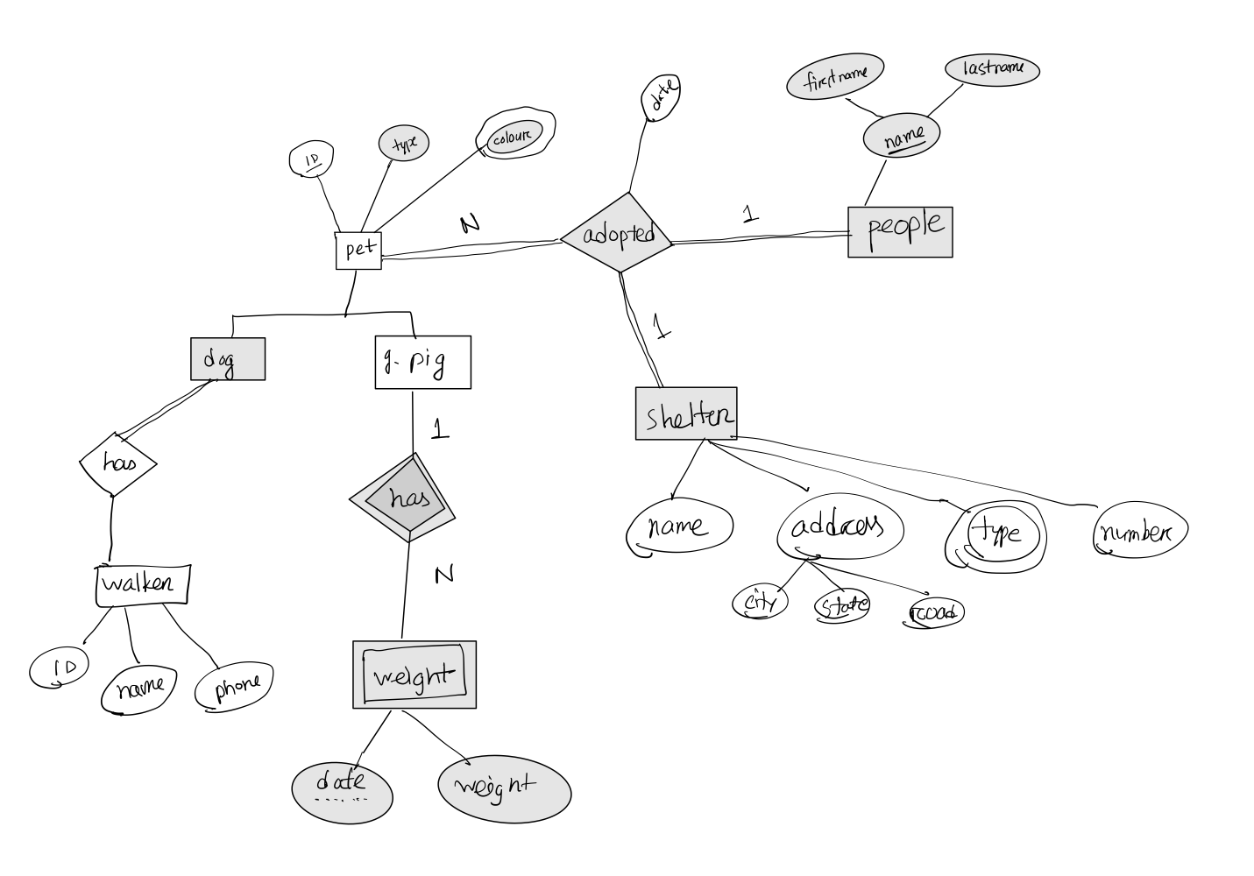
Identify the relationships
Only guinea pigs are weighed each day.
Dogs are each assigned a dog walker at the shelter. The dog walkers have a unique identifier, a name and a phone number.
Specialization

Slide 13
Final ER

